Slide 1
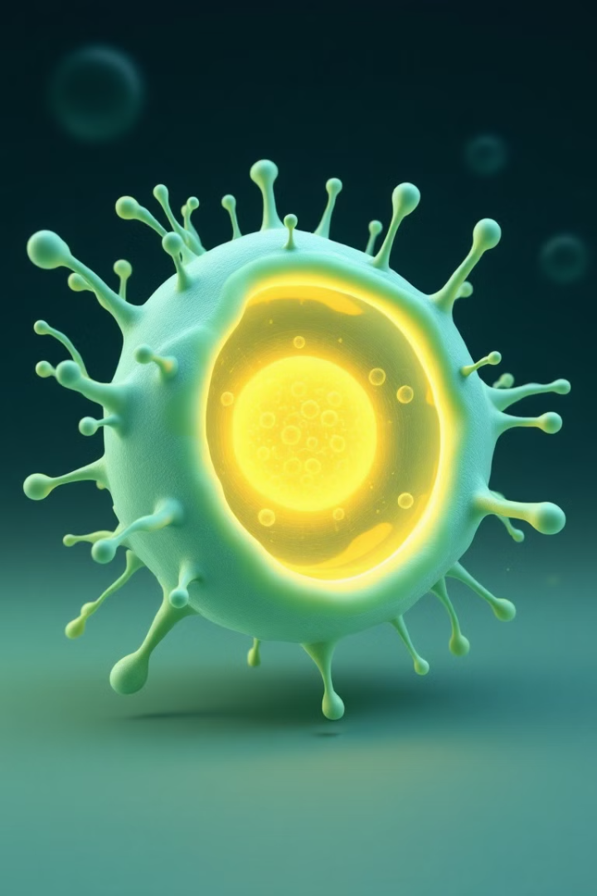
Peroxysomes: The Unsung Heroes of Cellular Function
Explore the fascinating world of peroxysomes, essential cellular organelles that play a vital role in a wide range of biological processes.

Slide 2
What are Peroxysomes?
Tiny Organelles
Metabolic Powerhouses
Peroxysomes are small, membrane-bound organelles found in the cytoplasm of almost all eukaryotic cells.
Despite their size, they play a crucial role in various metabolic pathways, including lipid metabolism and detoxification.

Slide 3
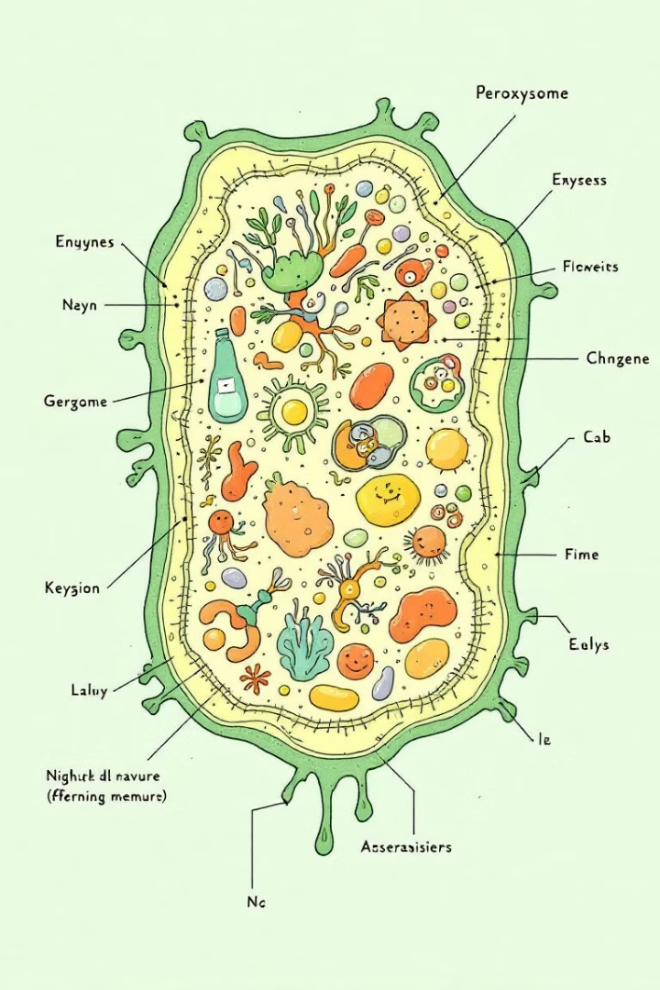
Structure and Composition of Peroxysomes
Single Membrane
Diverse Enzymes
Peroxysomes are surrounded by a single membrane that separates their interior from the cytoplasm.
They contain a variety of enzymes that catalyze various biochemical reactions, including oxidative reactions.
Self-Replication
Peroxysomes can grow and divide independently, ensuring their presence in the cell.

Slide 4




Key Functions of Peroxysomes
Breakdown of Fatty Acids
Detoxification
Peroxysomes play a critical role in the beta-oxidation of fatty acids, a process that generates energy for the cell.
They help detoxify the cell by breaking down harmful substances, such as hydrogen peroxide.
Synthesis of Lipids
Peroxysomes are involved in the biosynthesis of certain lipids, such as plasmalogens, essential for cell membranes.

Slide 5



Role in Fatty Acid Metabolism
Beta-Oxidation
1
A crucial process for energy production in cells.
Fatty Acid Breakdown
2
Peroxysomes break down fatty acids into smaller molecules.
Energy Production
3
The breakdown products are used to generate energy for cellular processes.

Slide 6
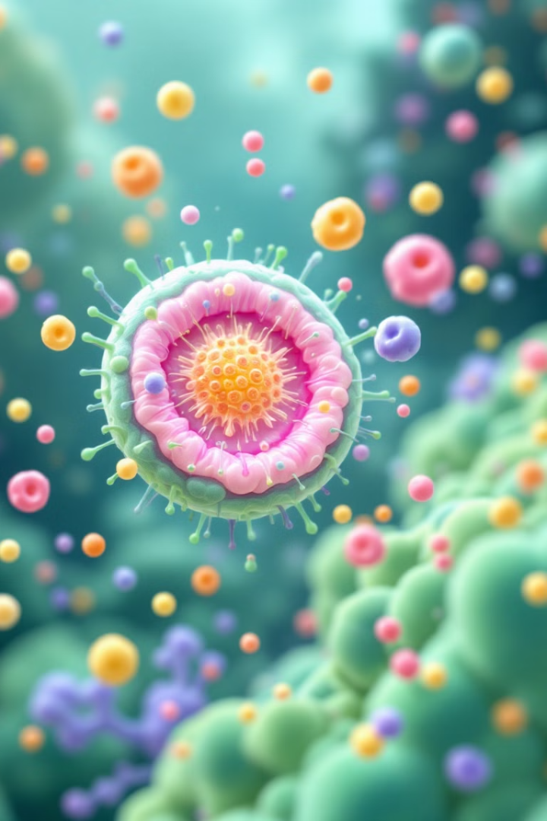
Peroxysomes and Hydrogen Peroxide Regulation
1
Hydrogen Peroxide Production
Peroxysomes are involved in the production of hydrogen peroxide, a reactive oxygen species.
2
Catalase Enzyme
They contain the enzyme catalase, which breaks down hydrogen peroxide into water and oxygen.
3
Oxidative Stress Protection
This process protects cells from oxidative stress caused by excessive hydrogen peroxide.

Slide 7
Diseases Associated with Peroxisomal Dysfunction
Zellweger Syndrome
1
A severe genetic disorder that affects the formation and function of peroxysomes.
Adrenoleukodystrophy
2
A rare inherited disorder that affects the breakdown of very long chain fatty acids.
Refsum Disease
3
A metabolic disorder that affects the breakdown of phytanic acid, a type of fatty acid.

Slide 8

The Future of Peroxisomal Research
1
2
New Therapies
Drug Delivery
Ongoing research aims to develop new therapies for peroxisomal disorders.
Peroxysomes are being investigated as potential targets for drug delivery systems.
3
Understanding Roles
Further research aims to understand the full spectrum of peroxysomal functions in health and disease.

